Slide 1

PRESENTATION OF EKPSY
MOBILE PSYCHIATRIC UNITS FOR REMOTE PLACES (MOUNTAINOUS AREAS AND ISLANDS).
EMPHASIS ON THE ACUTE PHASE CARE AT THE PATIENTS HOME AND ON THE CONTINUOUS FOLLOW-UP.
http://www.ekpse.gr/

Slide 2

THE MOBILE PSYCHIATRIC UNIT: the beginning…
The Mobile Psychiatric Unit started at Fokida Prefecture as a pilot project of the SSP&MH in 1981, to stop people suffering from psychosocial problems to be placed in the big Psychiatric asylums and in order to prove its efficacy in meeting people’s needs where they live.
Target group : children, adolescents, adults, elderly with simple or severe mental health and disability problems, (excluded drug addicted). We see the individual in parallel with the parents and the family.
The success of the model which is based on sectorization, proved its benefit by being incorporated in the Law 2716/1999 of the Greek Psychiatric Reform. Nowadays there are 25 Mobile Psychiatric Units in Greece.

Slide 3
Mobile Psychiatric Units of the S.S.P.&M.H
Τhe M.H.U of Thraki prefecture covers the states of Evros (149.354) & Rodopi (112.039). Evros is the north most regional unit, of Greece. The total areas visited by the M.H.U is 6. More precicely, in Rodopi state the M.H.U visits (Sapes - Filira Comotini- Iasmos,), and in Evros state (Soufli-Tihero,Didimotiho, Orestiada & Alexandroupolis).The main area of work is the city of Alexandroupolis . Alexandroypolis (72.959) is the capital city of Evros, it consists of an important port, and commercial center of north-east Greece which is considered sectoralised with multiple mental health services integrated in the primary health care system.
The state of Fokida, is situated in middle-central Greece, is a hilly, rural area, it consists of many small towns or villages, mostly mountainous, with a relatively difficult access to the capital cities or to large urban centers like Athens. Fokida has an estimated population of around 48.000 people. The MHU of Fokida visits a total of 11 areas (Amfissa, Itea, Galaxidi,Eratini, Efpalio, Delfi-Chrisso, Gravia- Polydroso, Amfiklia, Lidoriki). The Fokida prefecture has the particularity of the total absence of any other mental health services in the private or public sector.

Slide 4
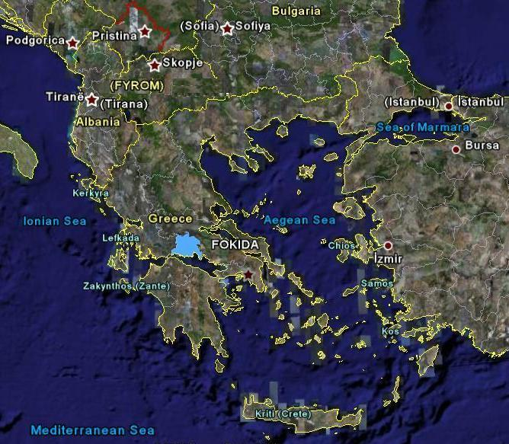


EVROS
RODOPI
FTHIOTIDA
FOKIDA
DELFOI
ATTIKI

Slide 5
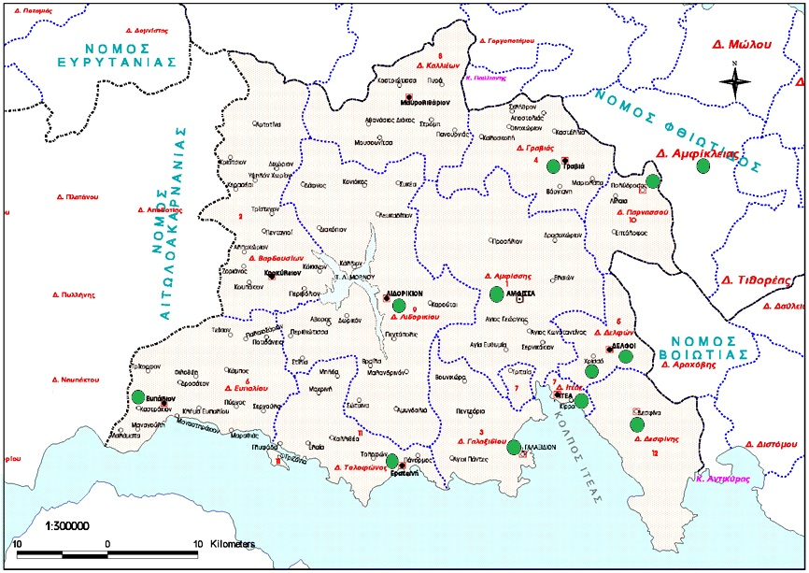
Mobile Mental Health Unit of Fokida:
The state of Fokida, is situated in middle-central Greece, is a hilly, rural area, it consists of many small towns or villages, mostly mountainous, with a relatively difficult access to large urban centers. It is estimated a population of around 45.000 people. The MHU of Fokida visits a total of 11 areas.

Slide 6
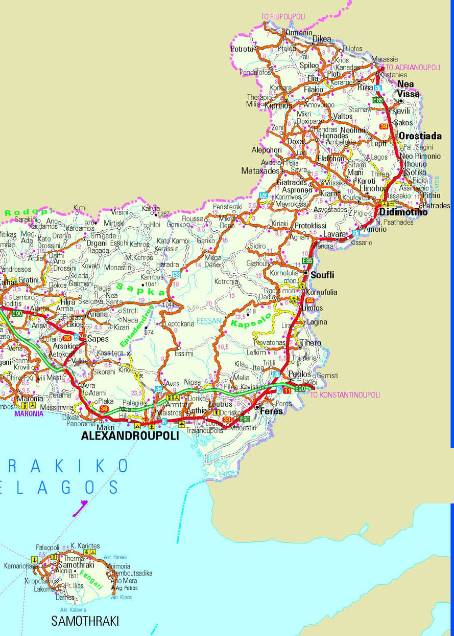
Mobile Mental Health Unit of Thrace

Slide 7
Aim of the operation of the Mobile Psychiatric Units:
Providing mental health services in the local community so that individuals with mental health problems can receive these services near their social and family environment;
Emphasis on a complete and systematic intervention for the prevention and rehabilitation of individuals with mental health problems (continuity of care), as well as the support of their family;
Development and ongoing application of community sensitization programmes;
Reducing the population’s difficulty of accessing mental health services;
Eliminating traditional institution-type practices by placing emphasis on out of hospital care and rehabilitation;
Cost – effectiveness: the early diagnosis and early treatment prevents the hospitalization of individuals with mental health problems.

Slide 8
Characteristics of the Mobile Psychiatric Unit (1)
A service that belongs to the community (local people are employed, staff working in the community and not behind the desks, feeling that the staff is available)
Flexibility (use action research for everyday work which is discussed every fortnight, SWOT Analysis every year or according to needs)
The needs of the population are guiding the establishment of services (discussions in forums or focus groups)
Mobile (offer services where needed : hospital, street, house, medical dispensary, church, school, local cafes, mayor’s office, neighborhood, etc)

Slide 9
Characteristics of the Mobile Psychiatric Unit (2)
The human being is a bio-psycho-social unit and operates as an individual, as a family member and as a community member.
The approach is psychodynamic (psychoanalytic prism): we try to understand the unconscious motives and fears of the patient, the family and ourselves as well.
The experience and knowledge which is acquired from the provision of services, is used in order to encourage and affect the continuous reform of mental health services in Greece. A situation which is still a challenge.

Slide 10
Services offered
Sensitization and education of people about mental health issues
Prevention Services. Prevention-promotion of mental health in the general population
Diagnostic Services.
  Prompt early diagnosis and treatment, prompt and valid intervention in children adult and families who suffer from mental health problems.
  Intervention in first episode of psychosis, and in psychosis relapses
Therapeutic Services.
  Psychiatric care of people with mild and severe mental health problems who are at risk of homelessness, psychiatric crisis and hospitalization.
  Stabilization of people with psychosis-continuity of care- elimination of crisis episodes, exclusion of hospitalization
Psychosocial support and Rehabilitation, Work Integration processes
Supported Employment (we also support the individual to maintain his/her employment position, even in periods of crisis

Slide 11
THE MOBILE PSYCHIATRIC UNIT
THE MODEL
The team’s main office is in the capital
Interdisciplinary group of 2-3-4-…(according to number of population served) staff members, visit regularly 10 small cities or villages in the prefecture, standard day, time, location :
therapeutic interviews of 30’ or 45’, each (the follow-up is continuous)
cooperation with the local doctor and nursing staff
visiting individuals with mental health problems or intellectual disabilities at their house for home treatment
Cooperation with the family and neighborhood (this is necessary, as the majority are people suffering from psychosis, which means we need to include all the environment for help)
visiting the local school, cooperation with police office, mayor, church
discussions in local cafes with inhabitants
community sensitization
searching for work opportunities-professional occupation
On call service for crisis intervention, offered in strict collaboration with the social group. A team of 2-3 staff members are available 24 hours a day for on call crisis intervention.
Liaison with other psychiatric or community services

Slide 12
The continuity of care and the elimination of relapses
  We provide a constant and continual follow up to the individuals with mental health problems, in order to prevent relapses and to promote their social inclusion.
  We offer support and psycho-education to their families, in order to help them to understand better the needs of the individual with mental health problems and to recognize early the beginning of a relapse. This way it is easier to avoid severe and dangerous relapses.
  We support the individual with mental health problems within the environment of his/her job and generally, in his/her social environment and in this way we reinforce the supporting network around him/her.
  Regarding Community Sensitisation Programmes, what is important is that the team of therapists working for the Mobile Psychiatric Unit in a local area recognise the specific local needs and get involved in the community’s activities, in order for the latter to understand and accept that mental health problems can be treated within the community.

Slide 13

The Mobile Psychiatric Units Model
Community
Psycho-education
Combating Stigma
& Social Exclusion
2. Crisis Intervention
3. Meeting people where
they live
Mobile
Psychiatric
Unit
6. Mental Health in
Workplace Settings-
Occupational
Rehabilitation
4. Mental Health in
Youth & Education-
Prevention-Primary
Intervention
5. Deinstitutionalization-
Housing solutions
CREATION OF LOCAL NETWORK

Slide 14

Anniversary Review of the Mobile Psychiatric Units of Evros and Fokida Prefectures for the decade 2001-2010
Clients
Individuals with psychosocial problems: 5,121 (Male 1,869, Female 3,252)
Number of therapeutic interventions: 197,718
Types of Interventions
Psychotherapy and other individual therapeutic interventions: 139,128
Family Intervention: 4,946
Socialization acts: 11,904
Pre-vocational Training – Employment: 10,495
Other Interventions – diagnostic assessment, crisis intervention, Psychiatric Intervention at the Patient’s home, psychological support, education in personal and social skills, vocational training support etc: 31,245

Slide 15

THE MOBILE PSYCHIATRIC UNIT Types of interventions

Slide 16
NUMBER OF PEOPLE USING THE SERVICES
YEAR 2015
M.H.U | users | New Users | Users Appointments
EVROS | 1315 | 502 | 9.923
FOKIDA | 631 | 284 | 7.731
Total | 1.945 | 786 | 17.654

Slide 17
Number of users among the areas visited by the Mobile Mental Health Units
FOKIDA

Slide 18
CHARACTERISTICS OF THE PEOPLE USING THE SERVICES
FOKIDA

Slide 19
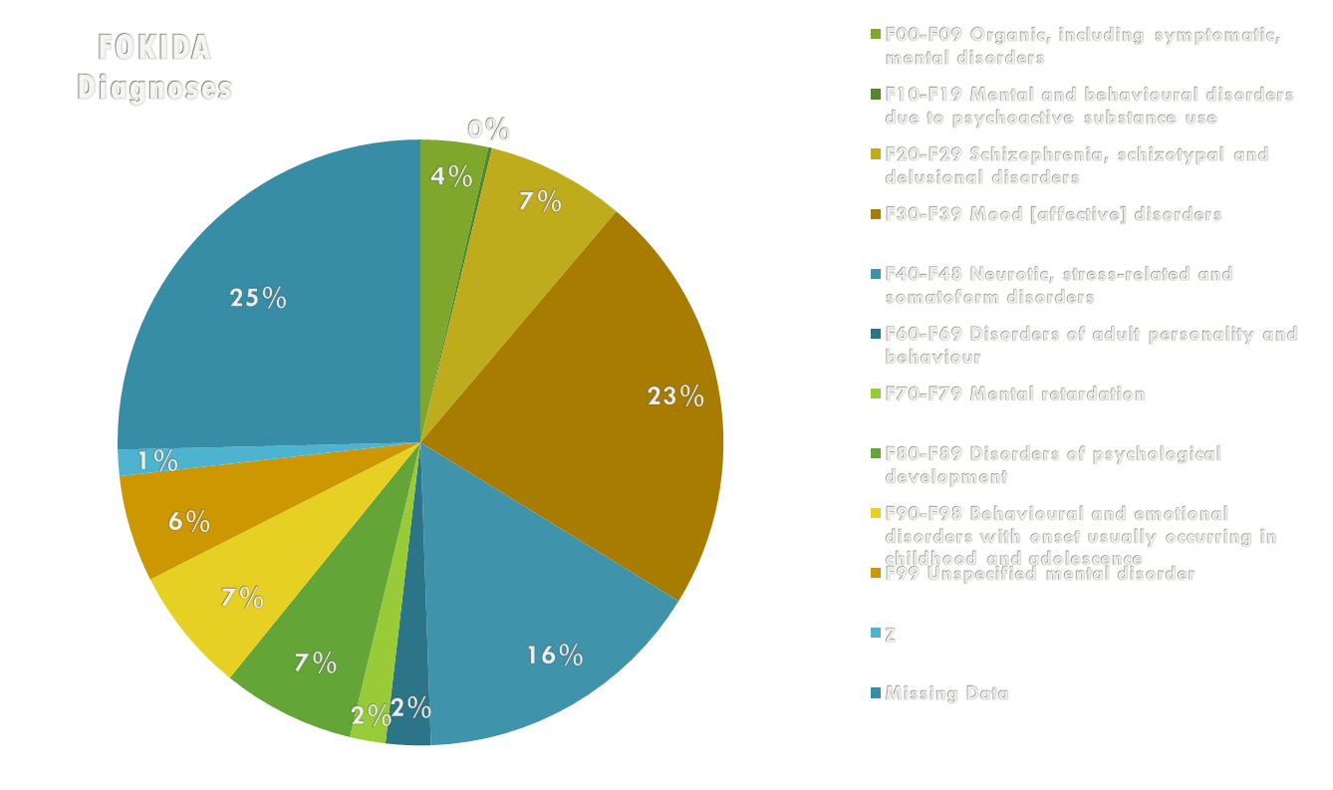
Distribution of Diagnoses

Slide 20
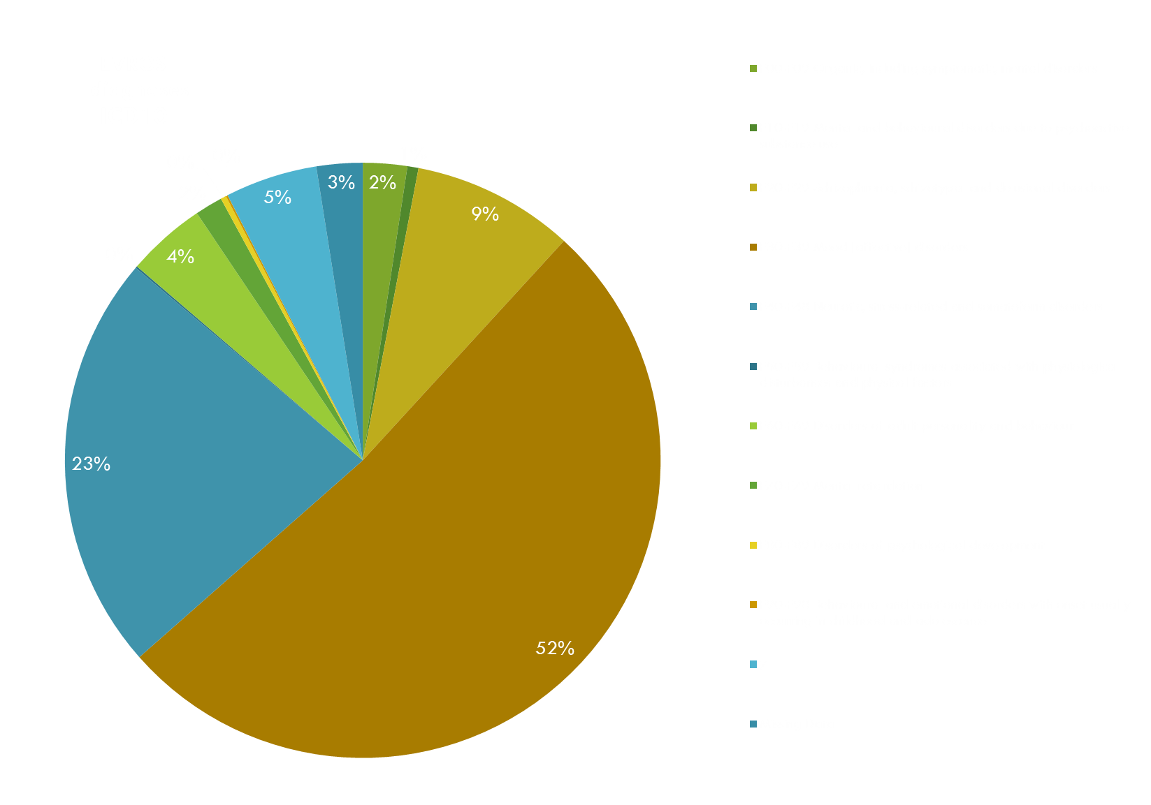

Distribution of Diagnoses

Slide 21

THE MOBILE PSYCHIATRIC UNIT
REFERENCES
In order to show the co-working of the mental health services with the public and local services of the prefecture, the following table is representative.
References to the Mobile Psychiatric Unit by :
Family – relatives | 22%
Public–local services non-psychiatric | 30%
Neighbors | 4%
Another user of the services | 12%
Self referral | 10%
Other(public psychiatric services, Private psychiatric services) | 26%

Slide 22
THE MOBILE PSYCHIATRIC UNIT
“Evaluate the 1st contact with the psychiatric mobile unit”
In a research regarding the evaluation of the quality of our services, the following feedback was given* :
* The tool created was by a collaboration between the Society of Social Psychiatry and Mental Health, and Prisma (Greece), European Center for Social Welfare Policy and Research (Austria), Portuguese Association for Cerebral Palsy – Center Region Nucleus (Portugal), National Association for the Housing of Handicapped Persons (Belgium), Association of Non-profit Human Services in Hungary, Social Innovation Foundation (Hungary), The Danish National Institute of Social Research (Denmark), Novi Paradoks (Slovenia)
 | Users | Staff
How easy was the 1st approach when asked | 65% | 84,6%
The user felt approached by respect | 95.8% | 100 %
The staff made the user feel comfortably | 100 % | 88 %
The user had enough time to explain his/her need/demand | 75% | 83.3%
The user felt that his/her case was understood and approached correctly | 91,7%
The user was given answers to his questions | 91,3% | 62,5%
How quick was the next appointment given | 95,2% | 88%

Slide 23

THE MOBILE PSYCHIATRIC UNIT
CRISIS INTERVENTION
THE HBPT MODEL
(HOME BASED PCYCHIATRIC TREATMENT)
The main principles of the model date back to 1960s and was first applied to the Mobile Units in 1980s.
The model was introduced in Greece by Professor P.Sakellaropoulos.
Home-based psychiatric treatment (HBPT), is applied today by the Mental Health Institute for Children and Adults (MHICA) based on the same principals
Though, it was a challenge to develop this service in an urban area (with less tight relations in the community), in a private non-profit organization (with more difficulties for people to pay for the services)
The model still remains successful both in urban and in rural areas

Slide 24
CRISIS INTERVENTION
THE HBPT MODEL
Therapeutic team and working framework
The therapeutic team consists of mental health professionals of different specialties (psychiatrists, psychologists, nurses, social workers).
The team’s work uses a psychoanalytic prism through which the unconscious mechanisms underlying the relationship between the individuals with mental health problems and the family are examined (and also the transference - counter-transference issues).
The team’s meetings and supervision are important factors since the function of the team is the therapeutic framework (the “holding” environment for the individuals with mental health problems).

Slide 25

CRISIS INTERVENTION
THE HBPT MODEL
HBPT is indicated for:
Acute psychiatric crisis of individuals with mental health problems
Individuals with mental health problems returning home after a long or short term hospitalization
Outpatients, who have never been hospitalized (Mobile Units of Fokida and Evros)
Stabilized individuals with mental health problems with mobility problems
The criteria include:
The existence of a stable enough environment (family, relatives and friends) in order to share the responsibility (with the therapeutic team and the individuals with mental health problems himself) of keeping the individual with mental health problems safe at home.
The exclusion of the possibility for the individual with mental health problems to be extra-violent. Regarding the suicidal people (most people in acute psychiatric distress have some level of suicidal thought), a significant part of the crisis assessment should be about assessing the individuals' intent, helping them understand it and assisting in ensuring their safety.
There can be combinations and modifications of technique according to psychopathology, family support, and risk issues.

Slide 26
The acute phase care at the patients home
At the beginning of a psychiatric crisis, a team of at least three therapists stays at the individual’s with mental health problems home almost all day, trying to establish a strong and trustful relationship with him/her and his/her family and provide him/her medicines. The most important thing is that in this crisis intervention we involve the family, the relatives, the friends and some people of the community, people that the individual with mental health problems trusts.
With our guidance and support these people stay beside the individual and create a safe and supportive environment, which eliminates the anxiety and the depression of the individual with mental health problems. In addition, we give responsibilities to the patient from the very beginning, even during the acute phase.
This way the individual with mental health problems recovers easier and faster and he/she avoids the hospitalization.

Slide 27

CRISIS INTERVENTION
THE HBPT MODEL/ Aims and benefits
  To avoid the painful involuntary hospitalization and the consequences of the break for the individuals’ with mental health problems family, social and professional life. Hospitalization often brings about regression, self-depreciation, stigmatization, family’s guilt and induces individual's with mental health problems persecutory fantasies. Compliance, responsibility and active participation in therapy are, thus, facilitated.
  To control the crisis in a shorter time, by making the individual with mental health problems and the family more responsible and actively involved in the therapy.
  To increase the individuals’ with mental health problems responsibility for their health and life, their self-esteem and functionality.
  To offer psycho-education to the individuals’ with mental health problems and their family, in order to recognize and successfully manage the early symptoms of a possible relapse. The individuals with mental health problems and their family are dealt with as a whole suffering system, even though the symptoms are not the same.
  To reduce the number of relapses and so to increase the individuals’ with mental health problems quality of life.

Slide 28

CRISIS INTERVENTION
THE HBPT MODEL/ Aims and benefits (cont.)
  To reinforce the social inclusion of individuals with mental health problems.
  To contribute to the Psychiatric Reform in Greece (There is a delay to the development of primary mental health care services in the community).
  To provide (short scale) evidence of the wider effectiveness of home psychiatric care during a crisis compared with the hospitalization.
  To expand the model of Mobile Units of Psychiatric Care at rural areas to the urban areas (big cities)
  To elaborate new techniques so that the model could be implemented in different social/cultural environments or different countries.
  To avoid the continuous re-hospitalizations, to reduce the amount of admissions into hospital within a community, reducing the human and financial cost of the crisis (for the individual, the family and the State).
  To avoid the stigmatization.
  To ensure the continuity in psychiatric care after the crisis intervention. When the acute phase is over, therapy is encouraged to continue in an integrated medical and psychosocial treatment program in MHICA.
  Therefore, HBPT is not an isolated activity but it is incorporated in a treatment network, which combines medical and psychosocial therapies (medicine therapy, psychotherapy, family therapy, Day Center services), in an attempt to respond continuously and cohesively to individuals’ with mental health problems various needs.

Slide 29
Psychosocial rehabilitation & Vocational training
Programmes of vocational training and psychosocial support for users.
social cooperatives-social firms (KOISPE VOLIKAS)
Community Sensitisation Programmes
Groups of empowerment
The procedure involves particular steps:
the use of tools (structured interviews or questionnaires).
selection of the particular vocation
Visitation program in the selected work.
Cooperation with the job instructor .
Provision of individual training
Evaluation and assessment of the work progress

Slide 30

CRISIS INTERVENTION
THE HBPT MODEL
Prompt intervention in psychosis
Prompt and acute intervention in psychotic individuals relapses either fist episode or repetition of episodes.
Psychiatric care in the patients home
Release of psychotic stress
Encouragement of accountability and self involvement.
Alteration of negative feelings and attitudes.
Intervention in cases of psychiatric hospitalization

Slide 31
CRISIS INTERVENTION
THE HBPT MODEL
Some data from the INSTITUTE OF MENTAL HEALTH FOR CHILDREN AND ADULTS .
The Institute provides HBPT services in Athens (capital city), while Mobile Mental Health Units provide services in remote areas
Data regarding HBPT services administered between 2000 and 2005 (Institute of Mental Health for Children and Adults) were analyzed so as to locate predictors of HBPT acceptance, adherence and outcome.
49 accepted to start the suggested home-based psychiatric treatment.
71 individuals with severe and acute mental health needs approached the Institute
Out of 49 individuals with mental health problems who initiated HBPT:
22 individuals (44.9%) finalized treatment after 19.6 (±13.8) months ;
19 individuals (38.8%) dropped out after 2.3 (±2.4) months;
7 individuals (14.3%) continued the treatment (follow-up).
None involuntary hospitalization took place!

Slide 32

CRISIS INTERVENTION
THE HBPT MODEL
Some data
HBPT Outcomes
71.4% of individuals with mental health problems improved
28.6% remained stagnant
Predictors of outcome:
Adherence and treatment duration were the sole predictors of outcome located.
HBPT seems to be an effective treatment option for these individuals with mental health problems .

Slide 33
CRISIS INTERVENTION
THE HBPT MODEL
Working Together…
The whole
Community
Informal Carers
(Families, Friends, Relatives, Siblings,
Employers…)
1)Society of Social Psychiatry and Mental Health and
2) Institute of Mental Health for Children and Adults (staff/volunteers/
networking with other organizations)
Individuals
with Mental
Health Problems

Slide 34
THE MOBILE PSYCHIATRIC UNIT
Working with the community
Basic aim: sensitization, education of population and anti-stigmatizing of mental health problems.
Wide variety of activities: seminars towards specific target groups, public speeches , tutorials, social forums, articles in public press etc.
Development of social networks: umbrella body of public and private social institutions
Continuous focus on training specific target groups in mental health issues.
M.H.U in Fokida: a Network called “AKESO” Network of Coordination and Cooperation of institutions around public health issues.

Slide 35
THE MOBILE PSYCHIATRIC UNIT
Working with the community
close collaboration with local authorities, health professionals and social services.
small communities: local key figures: mayor, the doctor, the pharmacist, the priest, the police, We are trying to get people to know and connect to the work being done.
We are gaining the commitment of influential local individuals and groups.
We are trying to mobilize available human recourses
We are trying to alter peoples negative attitudes towards mental health issues, by giving paradigms of positive behaviors, correcting myths and misconceptions
working with primary and secondary schools.

Slide 36
THE COMMUNITY FACTOR
CLINICAL SECTOR
COMMUNITY SECTOR
ACTION RESEARCH TRAINING SECTOR

Slide 37

THE MOBILE PSYCHIATRIC UNIT CONCLUSION
The efficacy of the model of the mobile unit is proven by the Greek state by adapting it in the law 2716/1999.
Mobile Units are increasing in Greece (25 now).
This approach has proved to be more human and cheaper than hospitalizations.
The big question and challenge is how to apply it in the big capitals and cities of Greece. In other words, how to increase the primary care (Mobile Units, Community Mental Health Services for Children, Adolescents and Adults)
Another big challenge is how this model (and especially the close relationship with the community) can be transferred in different countries and different social/cultural environments

Slide 38
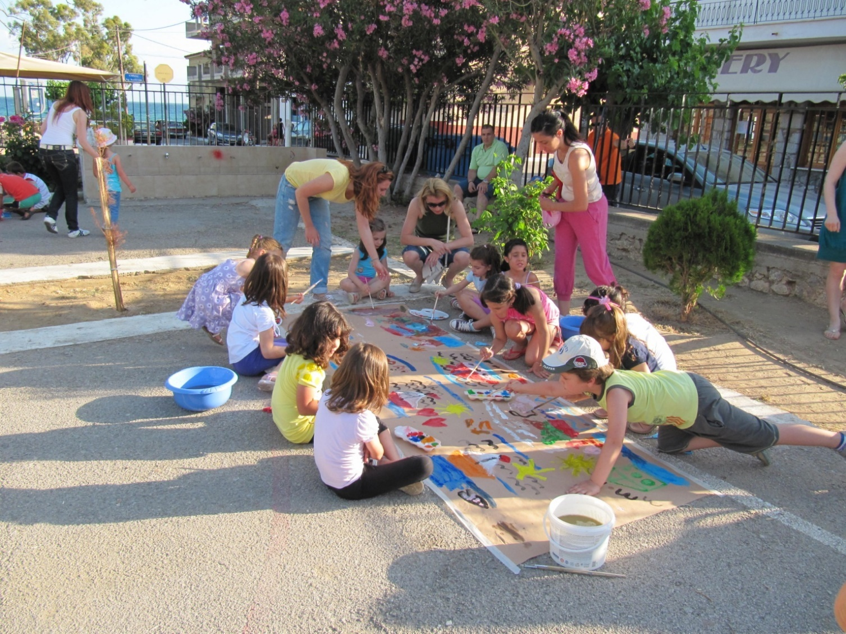

SENSITIZATION ON MENTAL HEALTH ISSUES
Activities with young children, parents and friends, in order to offer sensitization on mental health issues

Slide 39
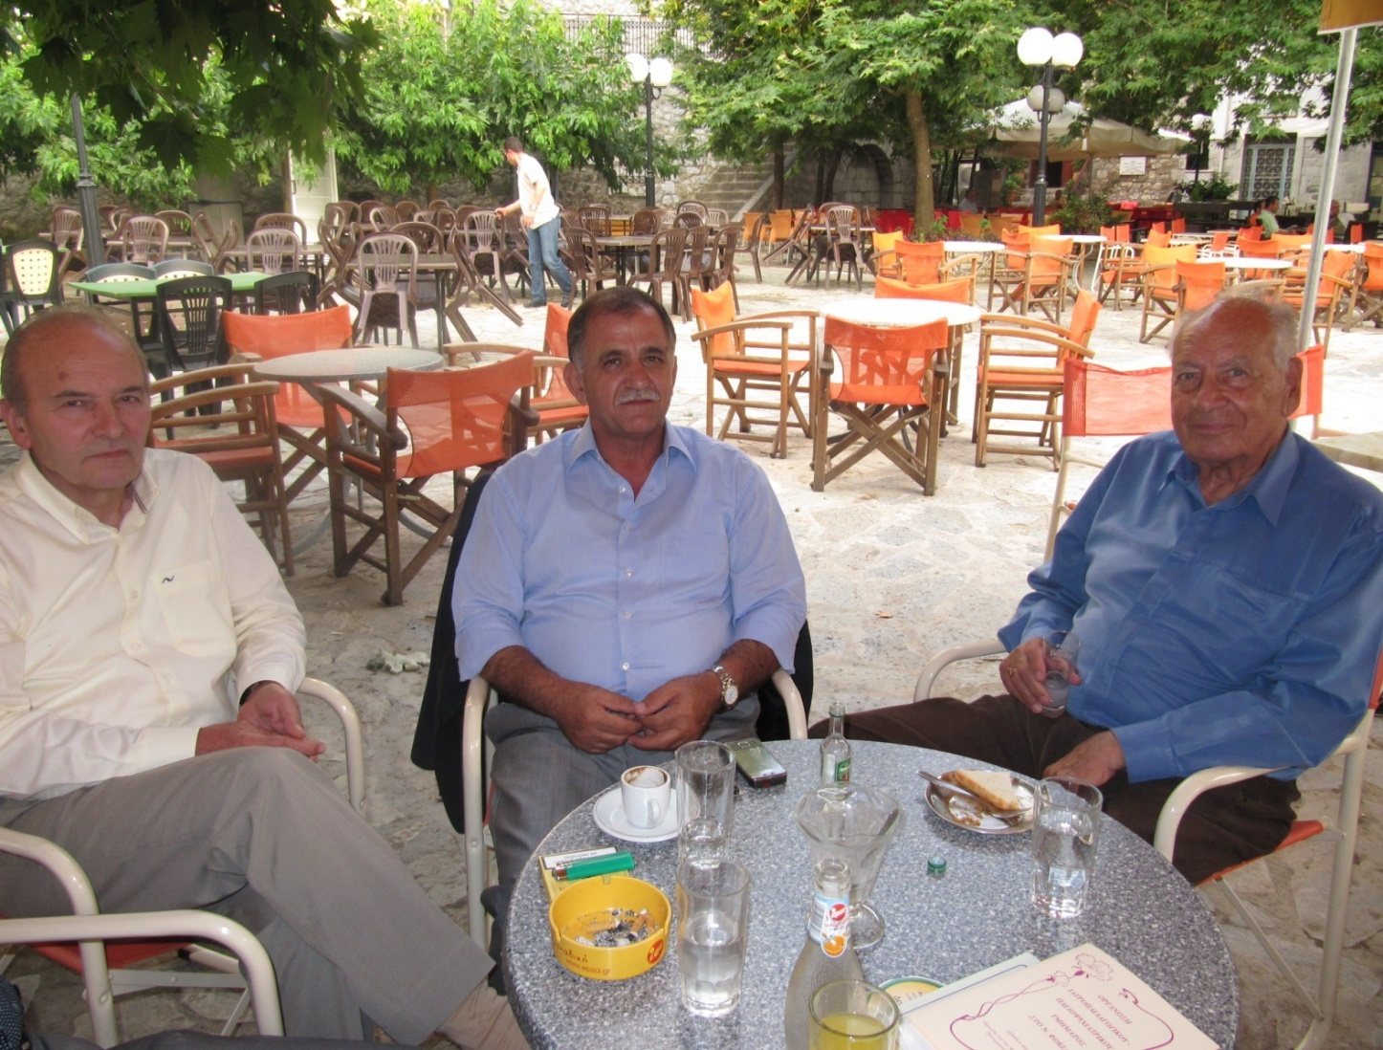

MEETING “KEY PEOPLE”
Professor Sakellaropoulos is meeting “key people” from the community in the local cafe, sensitizing them on mental health issues, or asking their help for an individual with mental health problems in their community

