Slide 1
The function of the mobile mental health units, by society of social psychiatry & mental health
LAZOGIORGOY ILIANA
PSYCHOLOGIST MSC

Slide 2
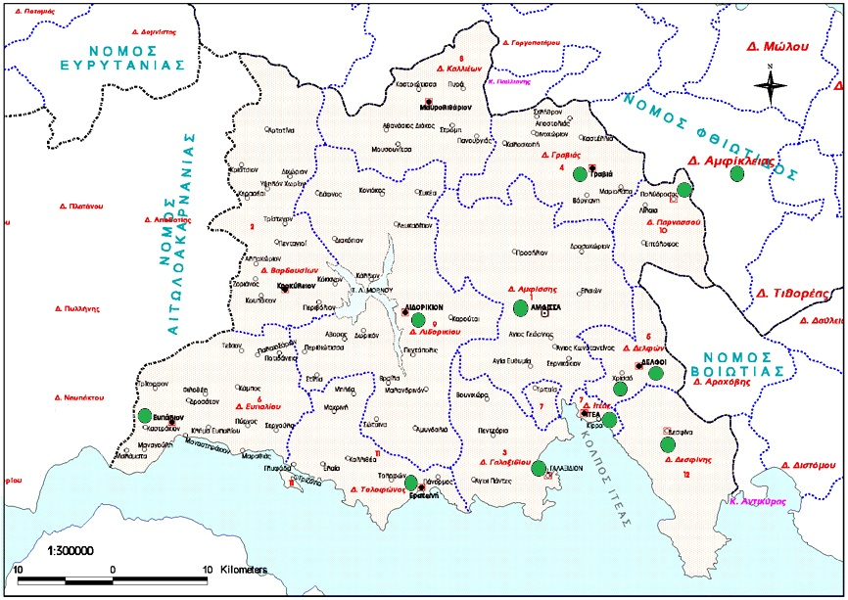
THE AREAS OF WORK:FOKIDA m.h.u

Slide 3

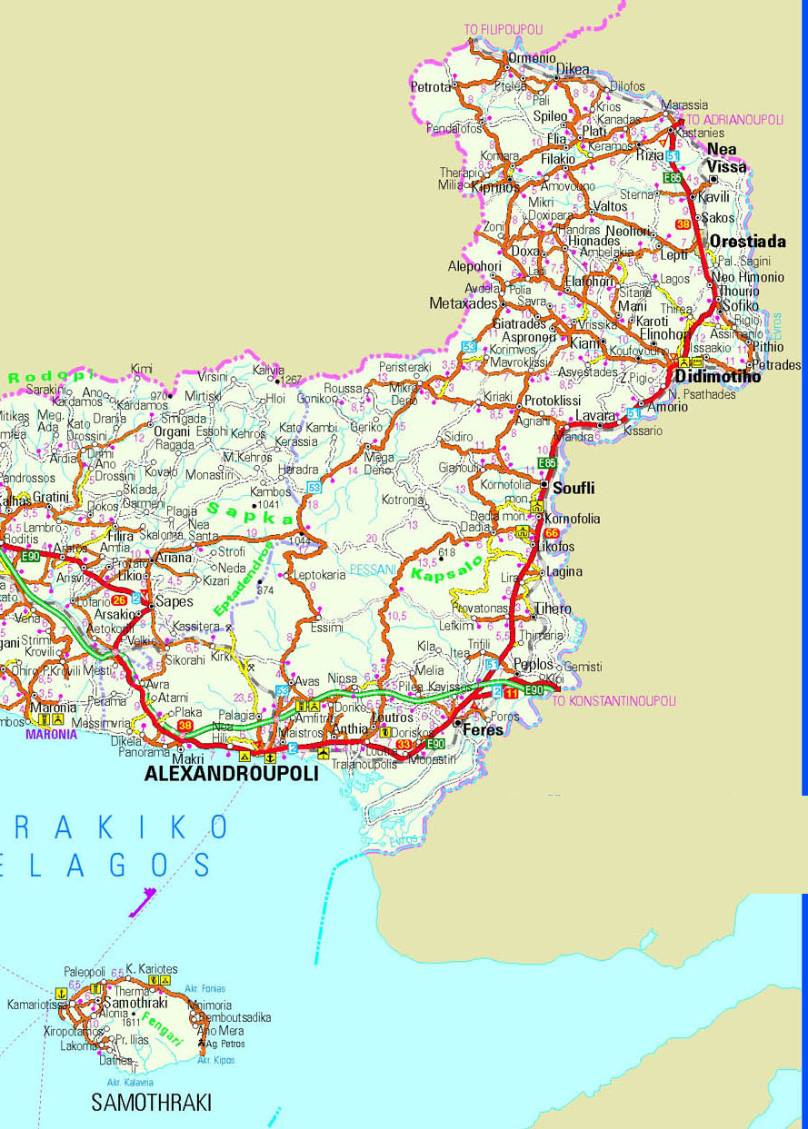
The areas of work: thraki

Slide 4
Areas of work: thraki & fokida
Τhe M.H.U of Thraki prefecture covers the states of Evros (149.354) & Rodopi (112.039). Evros is the north most regional unit, of Greece. The total areas visited by the M.H.U is 6. More precicely, in Rodopi state the M.H.U visits (Sapes - Filira Comotini- Iasmos,), and in Evros state (Soufli-Tihero,Didimotiho, Orestiada & Alexandroupolis).The main area of work is the city of Alexandroupolis . Alexandroypolis (72.959) is the capital city of Evros, it consists of an important port, and commercial center of north-east Greece which is considered sectoralised with multiple mental health services integrated in the primary health care system.
The state of Fokida, is situated in middle-central Greece, is a hilly, rural area, it consists of many small towns or villages, mostly mountainous, with a relatively difficult access to the capital cities or to large urban centers like Athens. Fokida has an estimated population of around 48.000 people. The MHU of Fokida visits a total of 11 areas (Amfissa, Itea, Galaxidi,Eratini, Efpalio, Delfi-Chrisso, Gravia- Polydroso, Amfiklia, Lidoriki). The Fokida prefecture has the particularity of the total absence of any other mental health services in the private or public sector.

Slide 5
NUMBER OF PEOPLE USING THE SERVICES
YEAR 2015
M.H.U | users
EVROS | 1315
FOKIDA | 631
Total | 1.945
YEAR 2015
MHU | Users Apointments
EVROS | 9.923
FOKIDA | 7.731
Total | 17.654
YEAR 2015
M.H.U | New Users
EVROS | 502
FOKIDA | 284
Total | 786

Slide 6
Number of users among the areas visited by the m.h.u’S

Slide 7
CHARACTERISTICS OF THE PEOPLE USING THE SERVICES

Slide 10
BASIC PRINCIPLES OF WORK
Prevention-promotion of mental health in the general population
psychiatric care of people with mild and severe mental health problems who are at risk of homelessness, psychiatric crisis and hospitalization.
  early diagnosis and treatment, prompt and valid intervention in children adult and families who suffer from mental health problems.
Prompt intervention in first episode of psychosis, and in psychosis relapses
Stabilization of people with psychosis-continuity of care- elimination of crisis episodes, exclusion of hospitalization
Psychosocial support and Rehabilitation, Work Integration processes
sensitization and education of people about mental health issues.

Slide 11
services provided
Diagnosis
psychiatric treatment,
medical treatment,
follow-up of chronic psychotic individuals,
children and adult psychotherapy,
psychosocial rehabilitation, support of daily functions
speech evaluation and therapy,
art therapy,
Drama therapy
Learning & language disabilities treatment
prompt intervention in psychiatric crisis, in the community
Support during individuals psychiatric hospitalization
Work with community- social networks

Slide 12
The multidisciplinary teams
Adult and Child Psychiatrists
Adult and Child Psychologists
Social Workers
Art therapist
Speech & language therapist
Drama therapist
Nurse

Slide 13
Continuity of care
Basic elements of work:
psychiatric care of people suffering from severe mental health disorders such as schizophrenia.
follow up treatment: psychological support, psychiatric care, family support, psychosocial rehabilitation, art therapy.
Basic aims
stable clinical condition
avoidance of relapses
good function in everyday life, and
to being able to regain work.
Basic tool: good trusting relationship with the patient & family

Slide 14
Prompt intervention in psychosis
Prompt and acute intervention in psychotic individuals relapses either fist episode or repetition of episodes.
psychiatric care in the patients home:
Release of psychotic stress
Encouragement of accountability and self involvement.
Alteration of negative feelings and attitudes.
Intervention in cases of psychiatric hospitalization

Slide 15
Psychosocial rehabilitation & Vocational training
programs of vocational training and psychosocial support for users.
. The procedure involves particular steps:
the use of tools (structured interviews or questionnaires).
selection of the particular vocation
Visitation program in the selected work.
Cooperation with the job instructor .
Provision of individual training
Evaluation and assessment of the work progress

Slide 16
Psychosocial rehabilitation and vocational training
social cooperatives-social firms (KOISPE VOLIKAS)
Community Sensitisation Programmes
Groups of empowerment

Slide 17
THE COMMUNITY FACTOR
CLINICAL SECTOR
COMMUNITY SECTOR
ACTION RESEARCH TRAINING SECTOR

Slide 18
Working with the community
Basic aim: sensitization, education of population and anti-stigmatizing of mental health problems.
wide variety of activities: seminars towards specific target groups, public speeches , tutorials, social forums, articles in public press etc.
development of social networks: umbrella body of public and private social institutions
Continuous focus on training specific target groups in mental health issues.
M.H.U in Fokida: a Network called “AKESO” Network of Coordination and Cooperation of institutions around public health issues.

Slide 19
Working with the community
close collaboration with local authorities, health professionals and social services.
small communities: local key figures: mayor, the doctor, the pharmacist, the priest, the police, We are trying to get people to know and connect to the work being done.
We are gaining the commitment of influential local individuals and groups.
We are trying to mobilize available human recourses
We are trying to alter peoples negative attitudes towards mental health issues, by giving paradigms of positive behaviors, correcting myths and misconceptions
working with primary and secondary schools.

Slide 20
Thank you very much for your attention!!!!

