Slide 1

FROM GLOBAL TO LOCAL
BUILDING INCLUSIVE LOCAL COMMUNITIES,
WITH A EU PERSPECTIVE
THE GREEK EXPERIENCE
SOCIETY OF SOCIAL PSYCHIATRY AND MENTAL HEALTH
ATHENA FRANGOULI,
EDF Board Member, representing Social Firms Europe CEFEC,
Vice President, Society of Social Psychiatry and Mental Health

Slide 2
The following map of Greece shows the 4 regions where the Society of Social Psychiatry and Mental Health is working

Slide 3
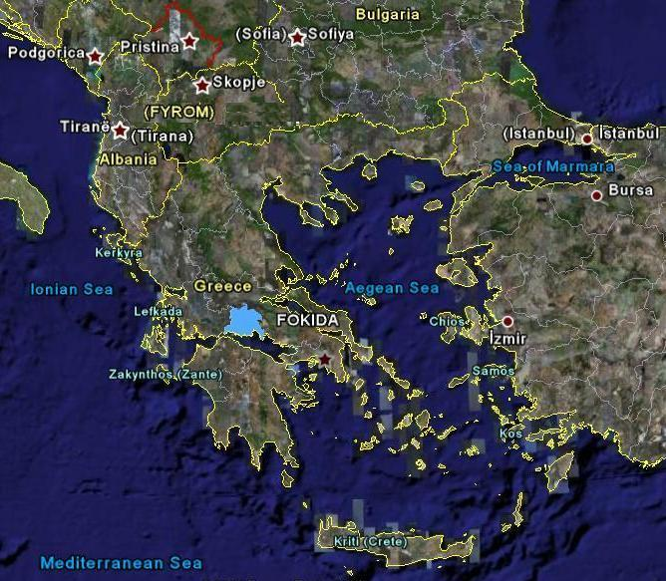


EVROS
RODOPI
FTHIOTIDA
FOKIDA
ATTIKI
DELFOI

Slide 4

Working Together…
Informal Carers
(Families,
Friends,
Relatives, Siblings,
Employers…)
Individuals
with Mental
Health Problems
The whole
Community
1)Society of Social Psychiatry and 2)Mental Health and Mental Health Institute for Children and Adults
(staff/volunteers/
networking with
other organizations)

Slide 5
SOCIETY OF SOCIAL PSYCHIATRY AND MENTAL HEALTH
Community
Psycho-education
Combating Stigma
& Social Exclusion
2. Crisis Intervention
3. Meeting people where
they live
Mobile
Psychiatric
Unit
6. Mental Health in
Workplace Settings-
Occupational
Rehabilitation
4. Mental Health in
Youth & Education-
Prevention-Primary
Intervention
5. Deinstitutionalization-
Housing solutions
CREATION OF LOCAL NETWORK

Slide 6





Slide 7
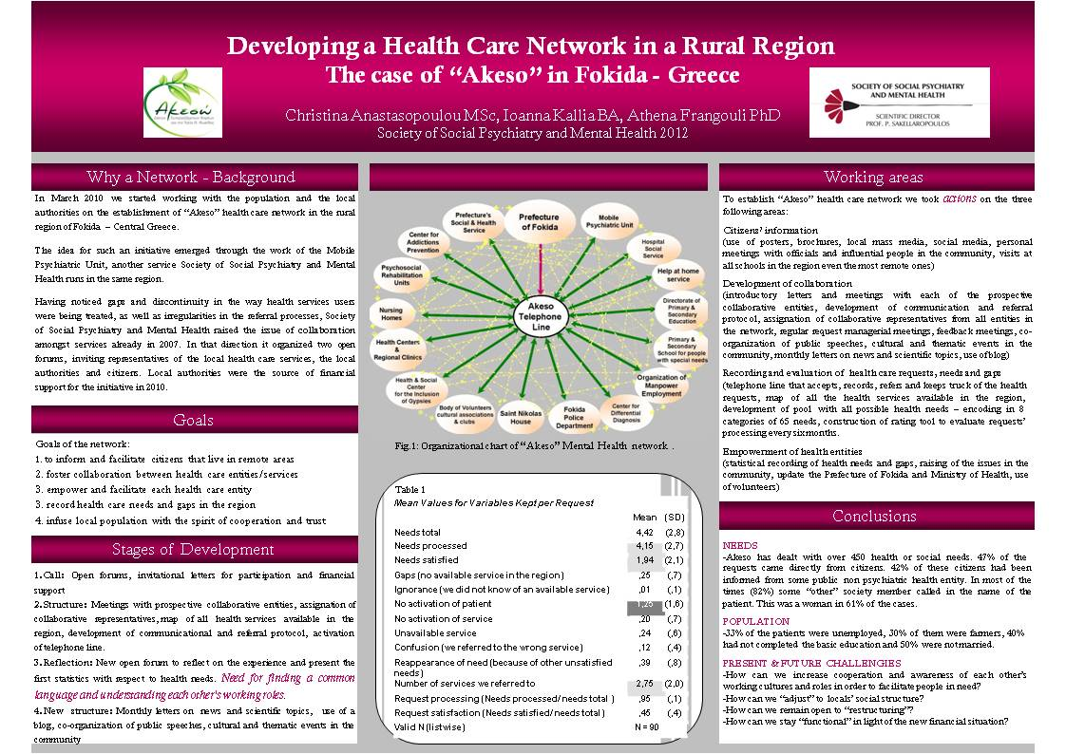

Slide 8
COMMUNITY SENSITIZATION ACTIVITIES

Slide 9
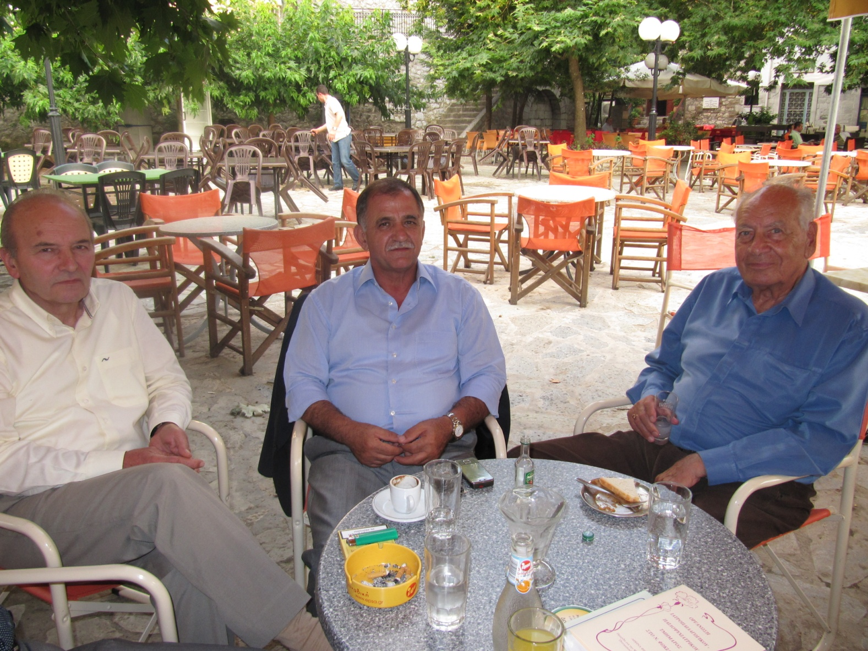
Professor Sakellaropoulos is meeting “key people” from the community in the local cafe, sensitizing them on mental health issues, or asking their help for an individual with mental health problems in their community

Slide 10
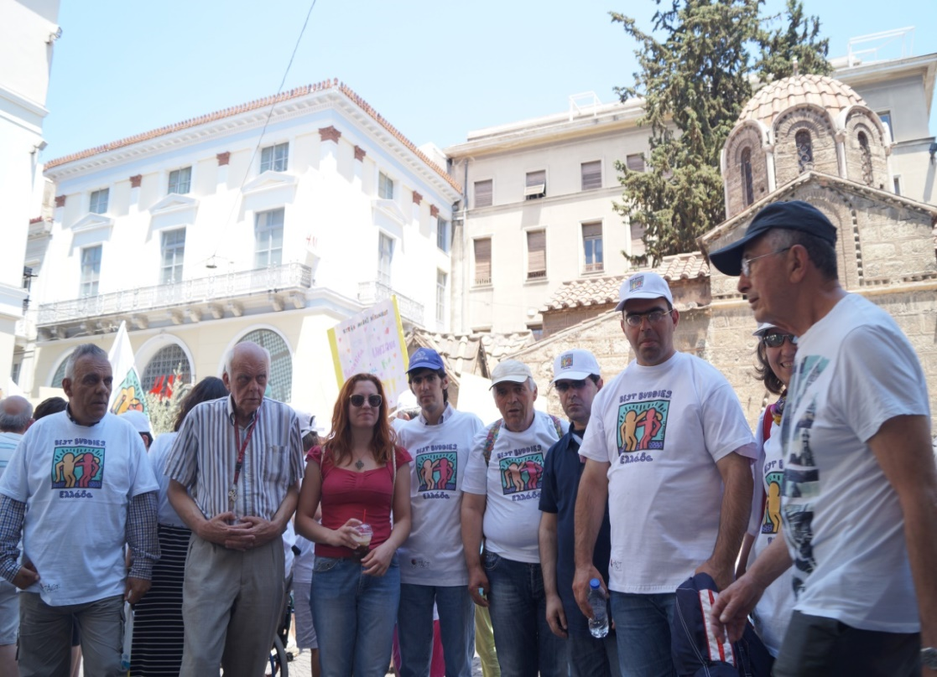
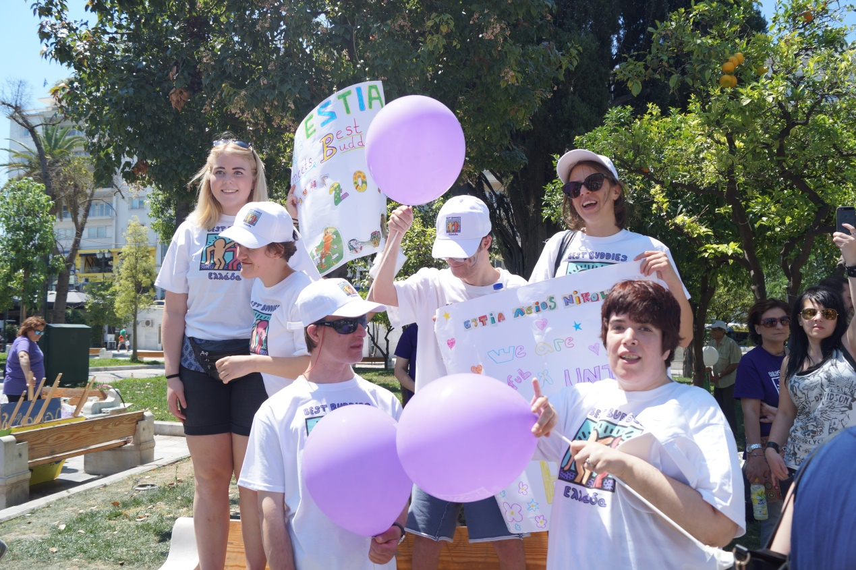

Slide 11

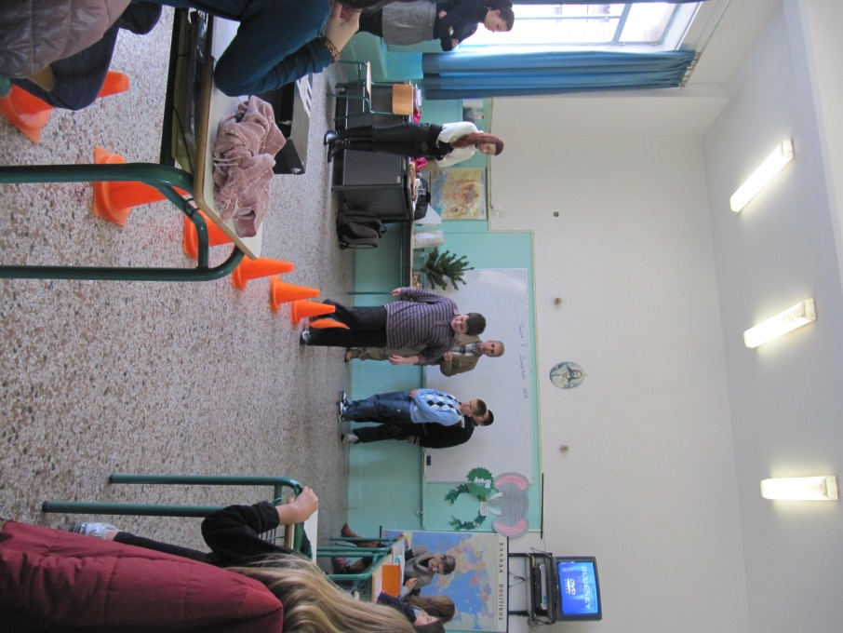

Slide 12
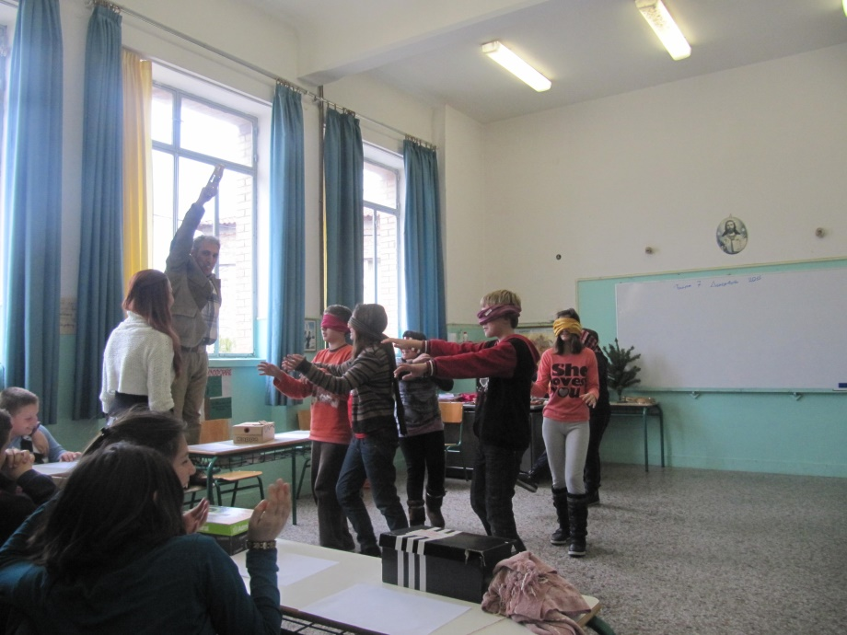
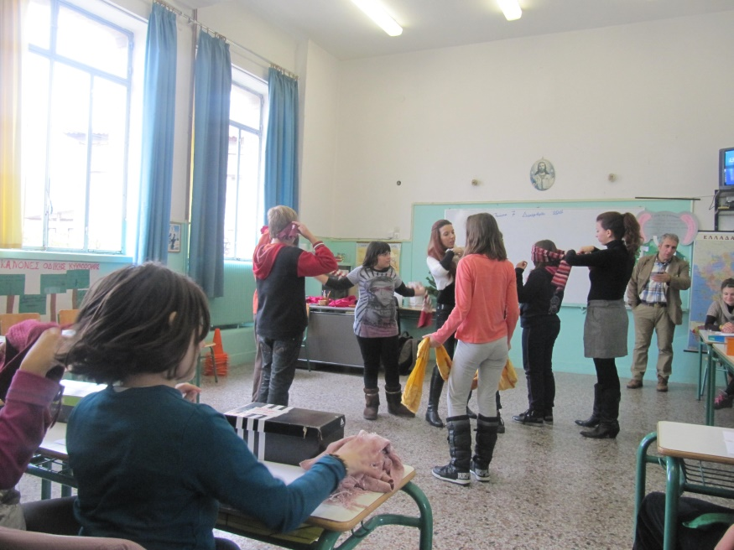
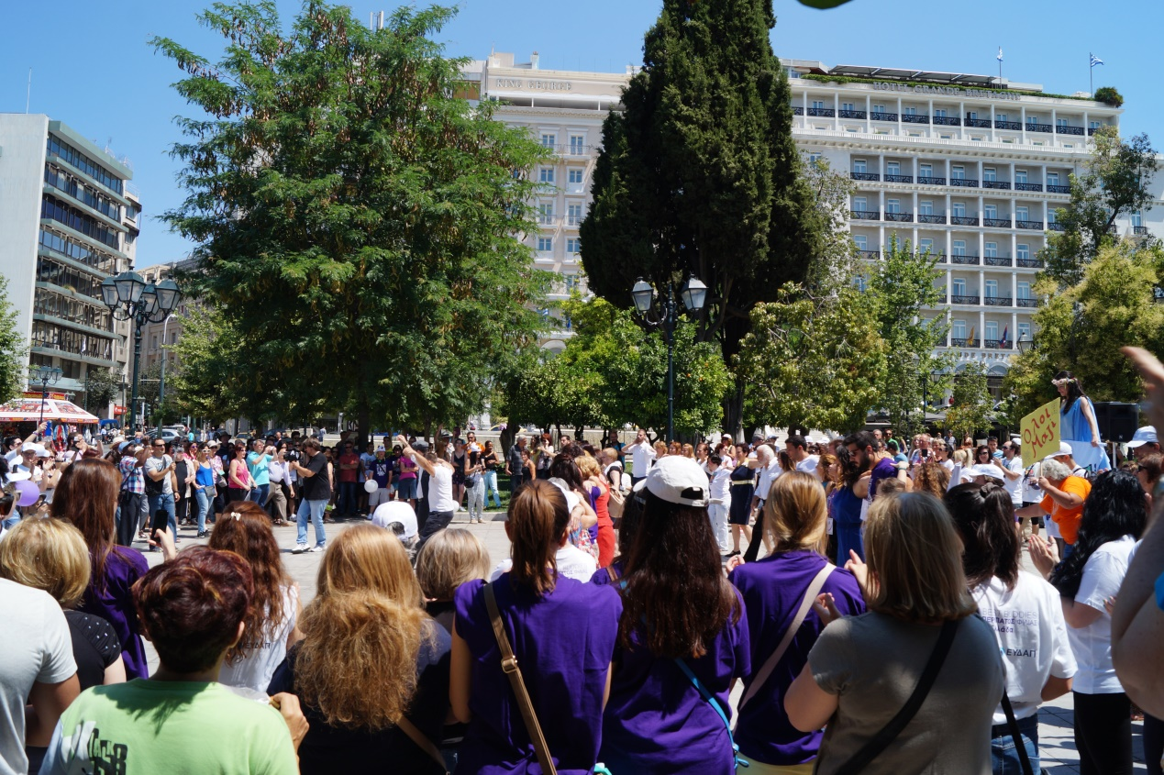

Slide 13


Slide 14
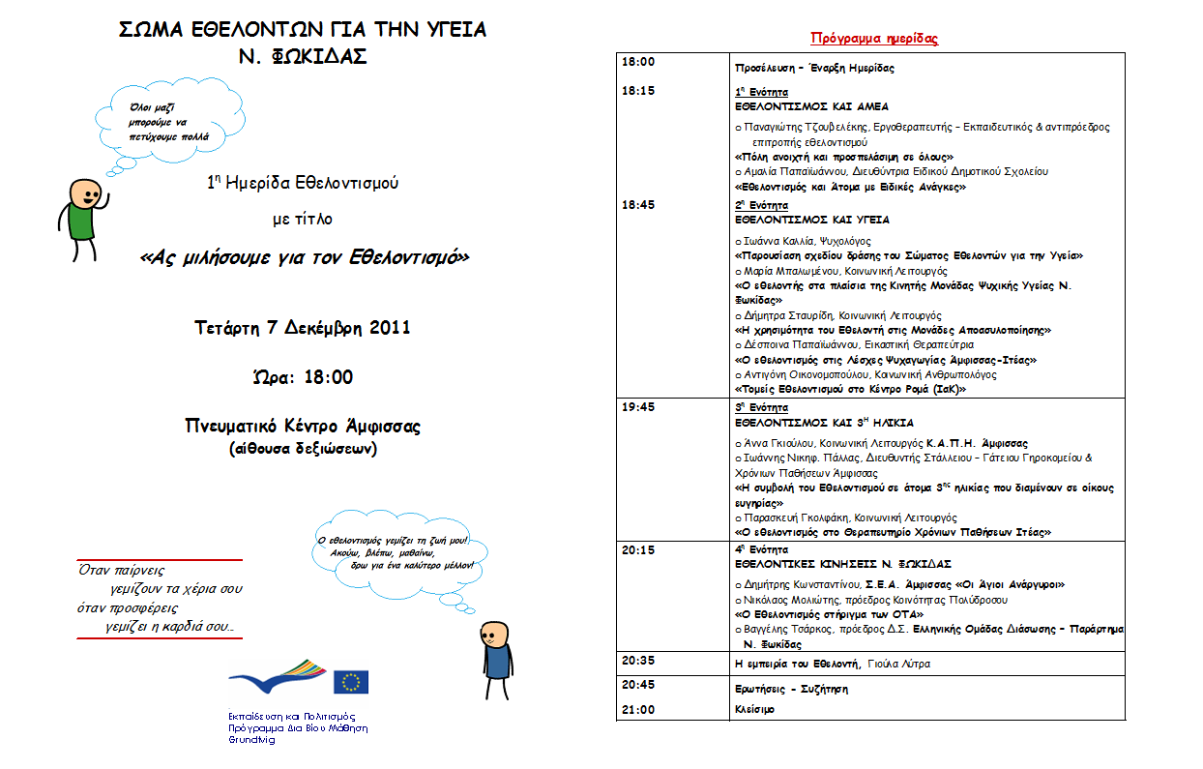

Slide 15
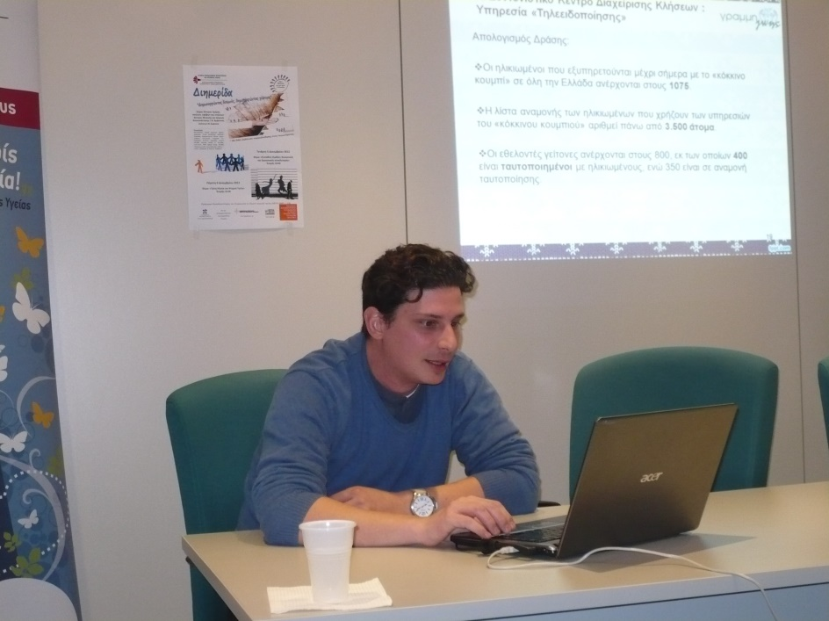
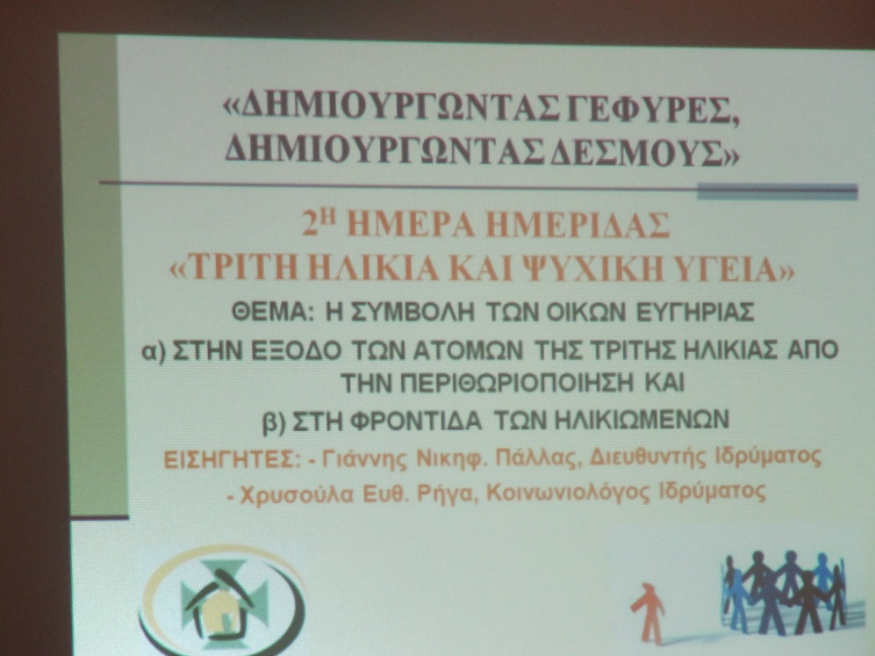

Slide 16



Slide 17

A JOURNEY TOWARDS CHANGE
P.O.K.oi.S.P.E-Pan-Ηellenic Federation of Social Cooperatives
THEMES :
GOVERNANCE
TRANSPARENCY
DECISION TAKING
SELF ADVOCACY
LOBBYING
NETWORKING
HUMAN RIGHTS IN MENTAL HEALTH
INCLUSIVE LEARNING
ACTION RESEARCH
COMMUNITY SENSITIZATION
CHANGE OF NEEDS – CHANGE OF ORGANIZATION
SOCIETY OF SOCIAL PSYCHIATRY AND MENTAL HEALTH
EDRA-"Social Cooperative Action for Vulnerable Groups” S.C.A.V.G
CAPACITY BUILDING
PEPSAEE-Pan-Hellenic Association for the Psychosocial Rehabilitation and Work Integration of Persons with Mental Health problems
EQUAL PARTICIPATION :
USERS
PROFESSIONALS
ADMINISTRATIVES
KEY PERSONS FROM COMMUNITY
AUTHORITIES
AKTAIA
See page 1 of the article

Slide 18


Slide 19
ACTION PLATFORM FOR THE RIGHTS IN MENTAL HEALTH
LOBBYING
EDUCATIONAL SEMINARS (WORKSHOPS) TO :
POLICEMEN
NATIONAL SCHOOL OF MAGISTRATES
PROFESSIONS IN MENTAL HEALTH SERVICES
ETC
WEBPAGE
ADVOCACY OFFICE
ORGANIZATION OF PANHELLENIC MEETING
NETWORKING
(CITIZENS’ INFORMATION POINTS FOR MENTAL HEALTH SERVICES)
OCCUPATIONAL REINTEGRATION (THROUGH SUPPORTED WORKING)
ADVOCACY AND SELF-ADVOCACY
RECOVERY
See page 2 of the article

Slide 20
SOCIAL FIRMS EUROPE – CEFEC FRAMEWORK
PSYCHIATRIC HOSPITALS
COMMUNITY
WORK
NETWORKING
OCCUPATIONAL ORIENTATION
COMMUNITY BASED SERVICES
CAPACITY BUILDING
TRAINING
OPEN MARKET
FAMILY
COMMUNITY
SUPPORTED EMPLOYMENT
MENTAL HEALTH
SERVICES
SHELTERED
SEMI-SHELTERED INDEPENDENT LIVING
SOCIAL COOPERATIVES
SOCIAL FIRMS
DEINSTITUTIONA- LISATION
RESOCIALISATION
WORK INTEGRATION
ARTICLE 17 : Protecting the integrity of the person
ARTICLE 26 : Habilitation and Rehabilitation
ARTICLE 16 : Freedom from Exploitation, Violence and Abuse
ARTICLE 10 : Right to Life
ARTICLE 8 : Awareness Raising
ARTICLE 19 : Living Independently and being included in the community
ARTICLE 25 : Health
ARTICLE 29 : Participation in Political and Public Life
ARTICLE 9 : Accessibility
ARTICLE 24 : Education
ARTICLE 27 : Work and Employment
ARTICLE 32 : International Cooperation
See www.cefec.org

Slide 21
THE NETWORK
TABLE
(2)
The process of de-institutionalisation
Members of the Board
Work framework
(4)
Local associations,
civil society
(5)
EU/Greek Ministries
European Networking
KOISPE
“Yannis Volikas”
Local Authorities
(3)
(6)
Entrepreneurial activities
(1)
Mobile Psychiatric Unit of the Prefecture of Fokida
Green house
Small factory for the creation of olive oil soap
Growth and sell of organic agricultural products
Sensitization
Psycho-Education
Alternative Tourist Agency
(7)

Slide 22
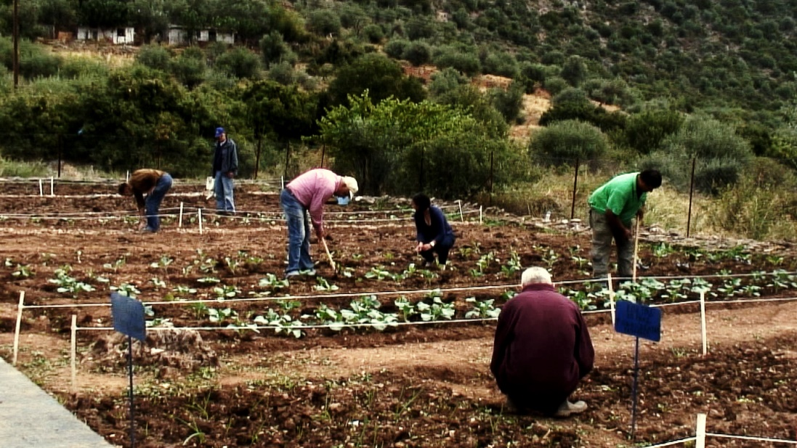

Slide 23
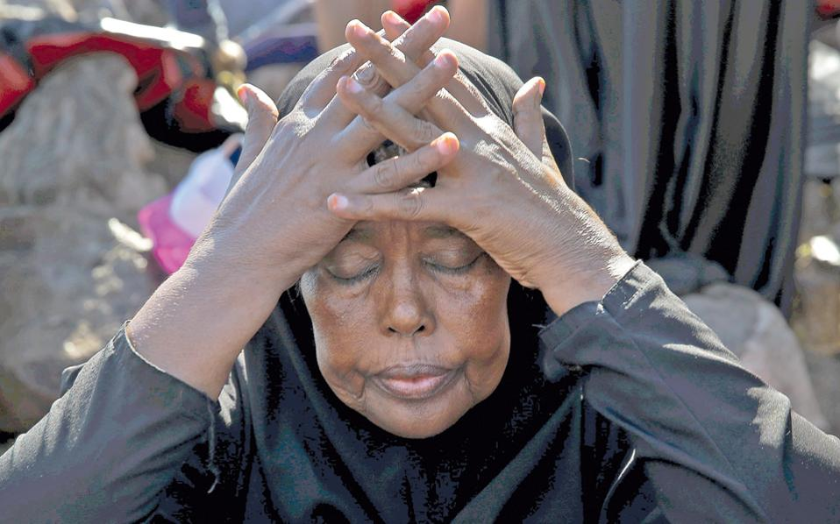
On what concerns refugees and migrants :
“A picture is worth a thousand of words”
Article 18
Liberty of Movement and Nationality

